Slide 1


Day 2

Slide 2
Starting remarks
Notes:
There are a lot of different concepts for this day, just to prepare you. I want you to keep in mind that on the last day there are a lot fewer new concepts and in general less programming to do, so it’s totally fine to not finish all tasks from this day today. There should be enough time in these last two days combined to do all the tasks. And as always, ask us if you need help.

Slide 3



Agenda
RX
TX
Timers/counters
Interrupts
Pulse width modulation
Analog to digital converter
USART
Task 1
Task 2
Task 3

Slide 4
Timers/counters – In general
Basically, like a plain stopwatch on your phone

Slide 5
Timers/counters – In general
Why do we care?

Slide 6


Timers/counters – In general
Count to 10

Slide 7
Timers/counters – In general
Okey dokey

Slide 8

Timers/counters – In general

Slide 9
Timers/counters – In general
I’ve finished counting chief

Slide 10
Timers/counters – In practice
We have multiple timers/counter on the AVR128DB:
Timer A
Timer B
Timer D
We will use this one
We need to tell the timer/counter what value to count to (in practice how many clock cycles)
We need to tell how quickly the timer should count, with a prescaler

Slide 11

Timers/counters – Prescalers
Prescalers determine the clock frequency of the timer/counter
Example
We set the prescaler to 2 so that the timer counts twice as slow as the microcontroller frequency

Slide 12
Timers/counters – Prescalers
Count to 5

Slide 13
Timers/counters – Prescalers
Okey dokey

Slide 14
Timers/counters – Prescalers

Slide 15
Timers/counters – Prescalers
I’ve finished counting chief

Slide 16
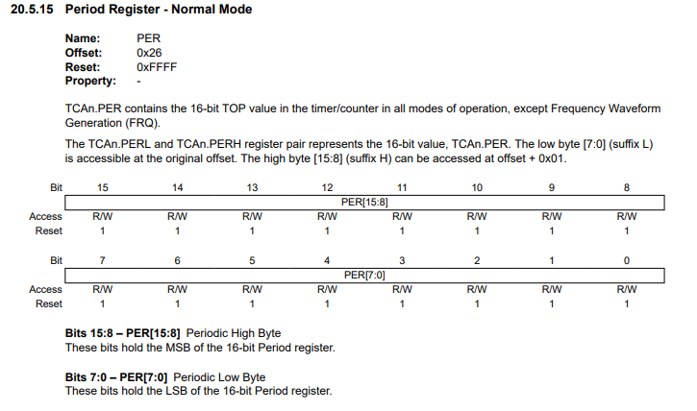
Timers/counters – Registers
We need to tell the timer/counter what value to count to (in practice how many clock cycles)
TCA0.SINGLE.PER = some_value;
The timer we want to use
We’re interested in the timer running in single mode
The register holding the value the timer will count to

Slide 17
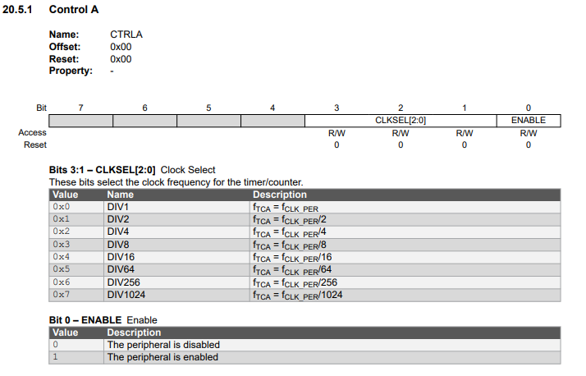
Timers/counters – Registers
We need to tell how quickly the timer should count, with a prescaler
TCA0.SINGLE.CTRLA |= TCA_SINGLE_CLKSEL_DIV2_gc;
The timer we want to use
We’re interested in the timer running in single mode
Register holding the prescaler
Use bitwise or and pass in the group mask for setting the prescaler to 2
We also need to enable the timer
TCA0.SINGLE.CTRLA |= TCA_SINGLE_ENABLE_bm;

Slide 18
Timers/counters – Single?
TCA0.SINGLE.CTRLA |= TCA_SINGLE_CLKSEL_DIV2_gc;
What is this?
The timer can run in single (16-bit) or split (two 8-bit)
Single
Split
Can count to 255 (the maximum value of an 8-bit number)
Can count to 255 (the maximum value of an 8-bit number)
Can count to 65 535 (the maximum value of a 16-bit number)

Slide 19
Timers/counters
Questions?

Slide 20
Interrupts – In general
Basically, like a notification on your phone
Notes:
I guess a good analogy is browsing the news on your phone, getting a snapchat notification, responding to it and then going back to browsing the news

Slide 21
Interrupts – In general
Why do we care?
Notes:
We care because on microcontrollers we are usually just running on a single core. And often we have limited processing capabilities. It would be a waste to continuously ask the timer if it has counted to 10. Rather we want to have a notification when the timer has counted to 10 so that we can do other things in the meantime. It frees up the CPU to do other things.

Slide 22
Interrupts – What are they?
Code blocks executed at some condition
Stops the main program flow temporarily, resumes immediately after the interrupt

Slide 23



Interrupts – Example
ISR = Interrupt service routine
The interrupt vector name
int main() {
while (true) {
// Doing some
// work here
// More code…
}
}
ISR (TCA0_OVF_vect) {
// Do something when the timer has
// finished counting to the value
// Tell the timer that we’ve received the
// notification (acknowledge the interrupt)
TCA.SINGLE.INTFLAGS = TCA_SINGLE_OVF_bm;
}
int main() {
while (true) {
// Doing some
// work here
// More code…
}
}
Notes:
Here it is important that one mentions the different syntax for the ISR and that we have to acknowledge the interrupt.

Slide 24
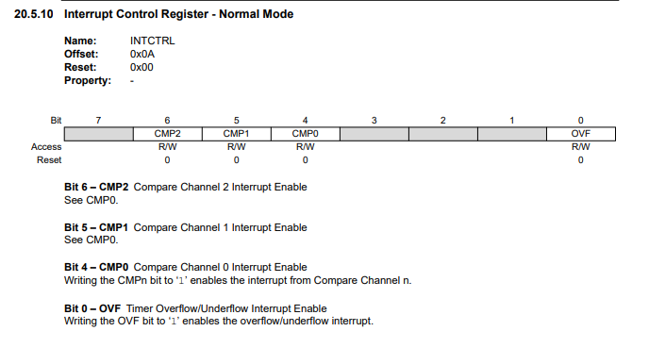
Interrupts – How do we configure these things?
We must enable interrupts globally. Done by calling sei();
We must enable the corresponding interrupt bit for the module we want interrupts from
We must include the code for the interrupt service routing with the correct interrupt vector name
ISR (TCA0_OVF_vect) {
// Some code
TCA.SINGLE.INTFLAGS = TCA_SINGLE_OVF_bm;
}
Notes:
Mention that they’ll see sei(); in the code. It means set enable interrupts(). If one would like to disable interrupts one can use cli(). Mention that for the timer we’ve spoken about we’re interested in the OVF interrupt.

Slide 25
Interrupts – Closing remarks
Keep them short
Interrupts are in most cases a better solution to your problem than using polling

Slide 26
Interrupts
Questions?

Slide 27

RX
TX
Timers/counters
Interrupts
Pulse width modulation
Analog signals
USART
Task 1
Task 2
Task 3

Slide 28
PWM
Demo

Slide 29
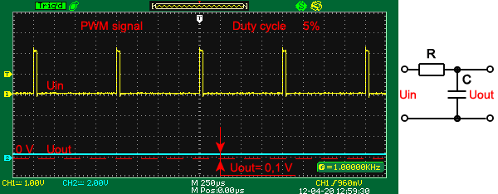
PWM – In general
A signal where we can vary how long the signal is low compared to high

Slide 30
PWM – In general
Why do we care?
Notes:
PWM is used in a lot of things. For example, motor control, LED brightness, digital to analog converters. Say you are building a radio controlled toy car, and you’d like to control how fast the car goes forward. You can do that by using PWM with the motors.

Slide 31
PWM – With the timer/counter modules
We can make the timers/counters output a PWM signal on a pin
Count
Period value (PER register)
Compare value (CMP register)
Time
PWM signal
PWM period
Notes:
Mention that this happens automatically, we don’t need to invoke interrupts or do anything, it just continues on its own.

Slide 32
PWM – With the timer/counter modules
We want to output a PWM signal on two pins for this task
We need to use split mode for the timer (every register should be on the form of TCA0.SPLIT.<register> = some_value;)
We then have two compare values (CMP1 and CMP2)
We need to tell the microcontroller what pins it should output the PWM signal on
We need to use port multiplexing
Hey, these pins are should be dedicated to the timer
Notes:
Mention that the reason that we need to use port multiplexing is that the default output for the TCA0 is PORTA, which is not connected to the LEDs we want to control on the extension board.

Slide 33
PWM – With the timer/counter modules
We want to output a PWM signal on two pins for this task
We need to use split mode for the timer (every register should be on the form of TCA0.SPLIT.<register> = some_value;)
We then have two compare values (CMP1 and CMP2)
We need to tell the microcontroller what pins it should output the PWM signal on
We need to use port multiplexing
No problem, I’ll set it up

Slide 34
PWM – Closing remarks
This is a task people usually struggle with, so read the comments in your handed out code thoroughly. It will point you in the correct direction.

Slide 35
PWM
Questions?

Slide 36
RX
TX
Timers/counters
Interrupts
Pulse width modulation
Analog to digital converter
USART
Task 1
Task 2
Task 3

Slide 37
Analog to digital converter – In general
Demo

Slide 38
Analog to digital converter – In general
Converts analog signals to digital values

Slide 39
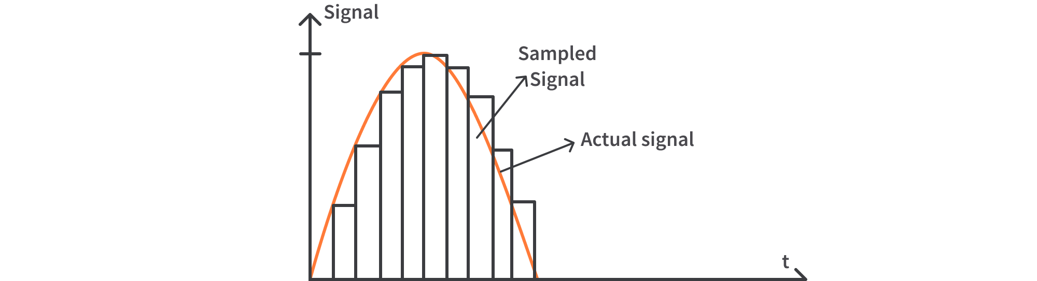
Analog to digital converter – In general
Digital value of 4095 for a 12-bit ADC (A 12-bit number can store up to 4096 different values)
5 V
Notes:
In this example, say that we have and ADC which operators on 10-bits and the maximum value of the input voltage signal is 5 V, then the top would be 511.

Slide 40
Analog to digital converter – In general
Why do we care?
Notes:
Well, the real world is analog, and most sensors will output an analog value, so we need a way to represent these analog values as digital values in order to do processing and make decisions based on them in a digital processor.

Slide 41
Analog to digital converter – What we need to setup
Analog
Digital
3.3 V
1023
Set bit resolution (10 bits in this task)
Set the number of samples per conversion
Set the reference voltage
Set the prescaler (how fast the ADC will run and thus sample signal)
Enable the ADC
0 V
0
Notes:
All these steps are in comments in the code. Look at the referenced sections in the datasheet which the comments mention.

Slide 42
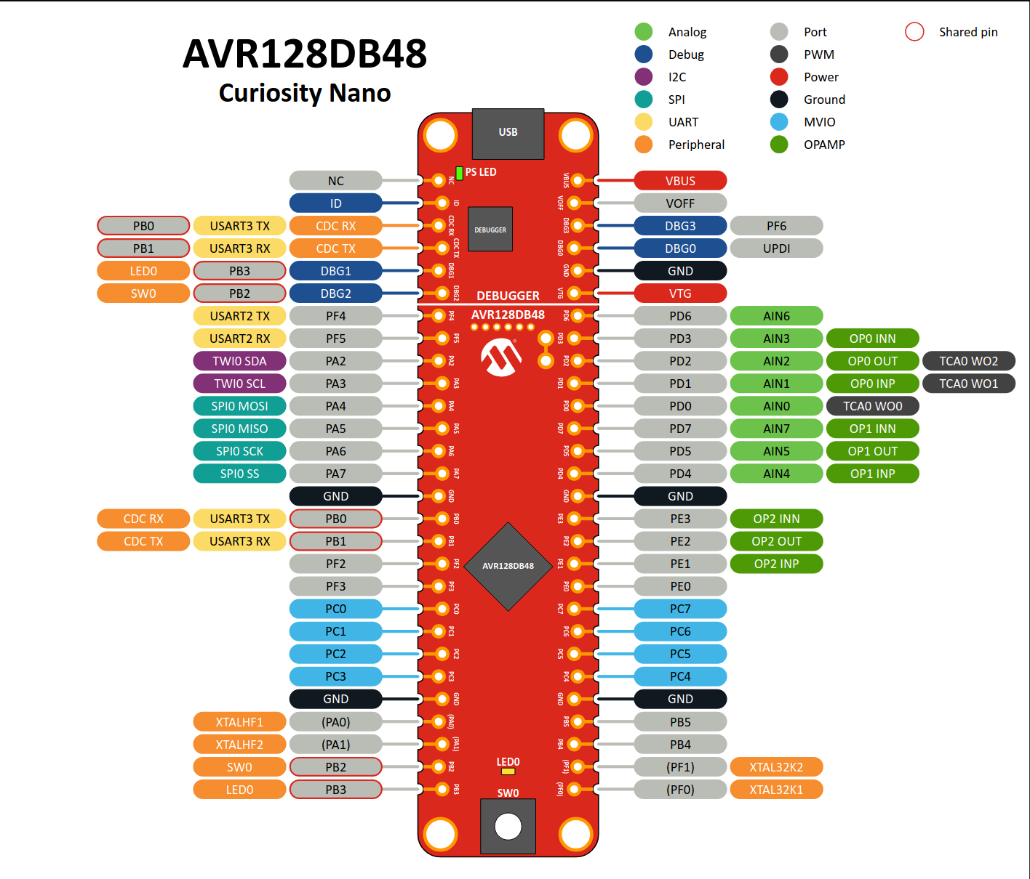
Analog to digital converter – How we get a sample
Choose which ADC channel to use
Start a conversion
Wait for it to complete
Read the value
The ADC has 8 channels

Slide 43
Analog to digital converter - Closing remarks
All the steps outlined are commented in the code with the datasheet sections. Ask us you have any questions

Slide 44
Analog to digital converter
Questions?

Slide 45
USART
RX
TX
A way to send and receive data
Universal Synchronous and Asynchronous Receiver and Transmitter

Slide 46
USART
RX
TX
Want to communicate?

Slide 47
USART
RX
TX
Sure fam

Slide 48
USART
RX
TX
How
quickly?

Slide 49
USART
RX
TX
What about 9600 bits/s

Slide 50
USART
RX
TX
Sure, let’s set it up

Slide 51
USART
RX
TX
TX
RX

Slide 52
USART
RX
TX
You there?
Yeah, cool beans

Slide 53
USART
RX
TX
Why do we care?
Notes:
Well, with microcontrollers we often want to send some data to another micorcontroller or a computer. USART is what we call a communication protocol. There are various of these protocols, but USART is one of the simplest one out there.

Slide 54
USART – Configurations
RX
TX
Need to specify baud rate
Need to specify bits per transfer (usually 8, so 1 byte per transfer).
There are some more configurations as well, but we won’t go into them (we’ll use the default values)

Slide 55
USART – How do we set it up?
RX
TX
Need to enable the TX pin for output (and optionally the RX pin for input).
Need to set the baudrate (bits per second) in the USART’s BAUD register. Both sides need to have the same baudrate.
Enable transmitter (and optionally receiver) for the USART module (in the CTRLB register of the USART module).
USART pins we’re going to use

Slide 56



USART – Baud rate formula example
RX
TX
USART3.BAUDL = (uint8_t) 1388 = 108;
USART3.BAUDH = (uint8_t) (1388 >> 8) = 5;
Notes:
This formula is for the asynchronous USART mode which we will use

Slide 57
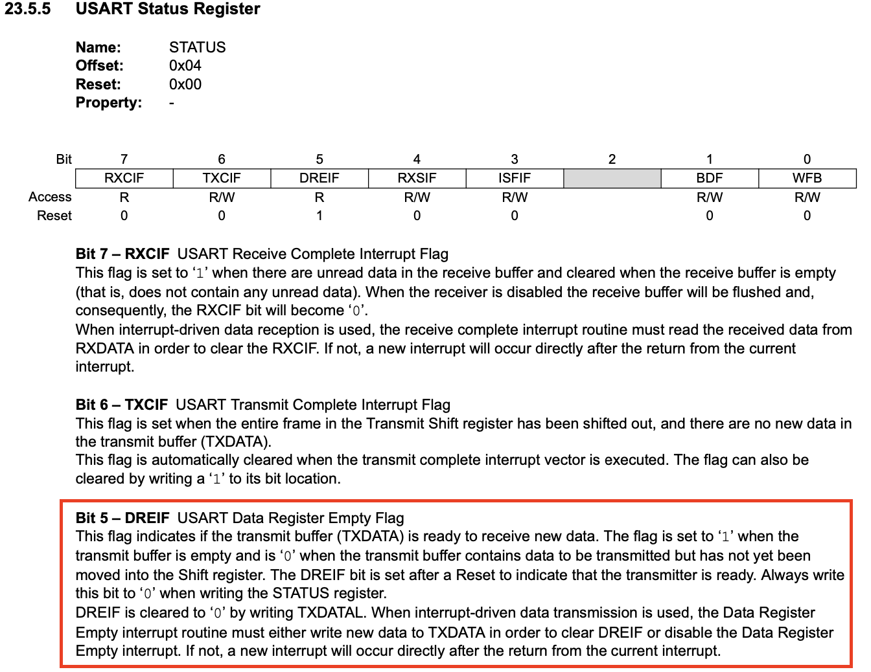
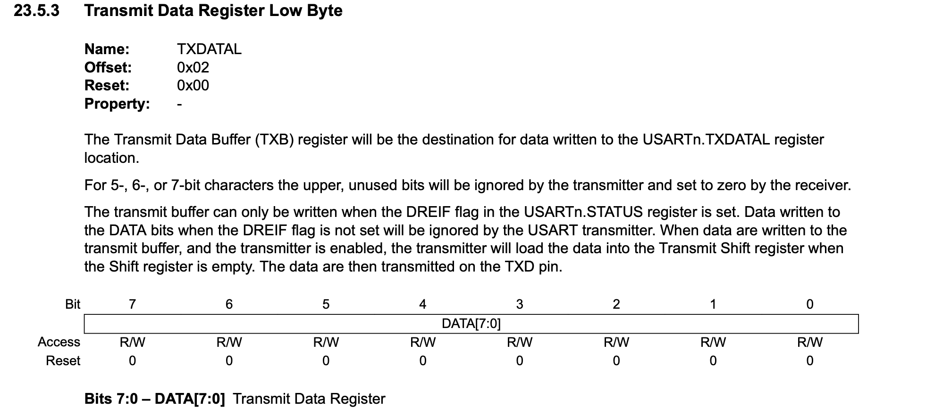
USART – Sending characters
RX
TX
Check if data is not currently being sent (USART’s STATUS register).
Set USART’s TXDATAL register to some value to send one byte.

Slide 58
USART – Sending strings
RX
TX
Strings in C are character arrays terminated with a null character (’\0’)
const char* hello_string = “hello”;
h | e | l | l | o | \0
Notes:
So, to send strings, we need to loop over the string for each character and send it until we reach the null termination.

Slide 59
USART
RX
TX
Questions?

Slide 60
RX
TX
Timers/counters
Interrupts
Pulse width modulation
Analog to digital converter
USART
Task 1
Task 2
Task 3

